Slide 1
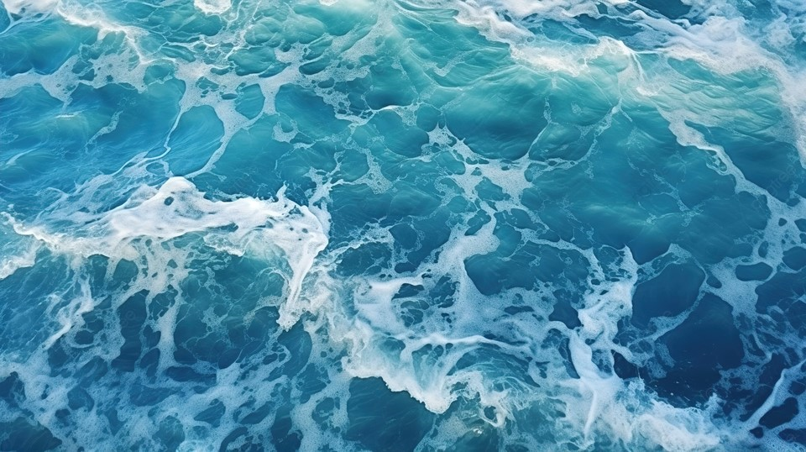
WATER QUALITY DATA ANALYTICS
GUIDED BY-MS.ARPITA MAM
CREATEDBY –MANJIMA BHATTACHARYYA

Slide 2

SL.NO | CONTENTS
1 | PROBLEM STATEMENT
2 | PROJECT OVERVIEW
3 | WHY WE NEED THIS
4 | SOLUTION
5 | MODELLING (ANALYSIS MODEL)AND VISUALISATION
6 | LIVE DEMO – ANALYSIS DASHBOARD
7 | RESULT(PREDICTION MODEL)
8 | THANKS

Slide 3
PROBLEM STATEMENT
The rank is based on the percentage of households which have access to safe drinking water. Punjab ranked highest with 97.6%, while Kerala has the worst rank with only 33.5% households having access to safe drinking water. National average stands at 85.5%.
Only 3 % of Earth's water is fresh water. 1 % of this fresh water is fit for drinking, rest is locked up in the ground, glaciers and ice caps
Our research includes testing water quality like ph, Turbidity (NTU), Temperature (°C), Dissolved Oxygen (mg/L),etc. Then we analyze our data .

Slide 4
PROJECT OVERVIEW
Our goal is to check the quality of water. As per normal water parameter in our dataset we have to check all of the parameter of water . So for that reason I choose this project.
so we started with jupyter notebook and gathered data, filtered it, then moved on to visualization, and eventually created a prediction model for this data set.

Slide 5
HOW IT HELP PEOPLE?
Parameters that are frequently sampled or monitored for water quality include temperature, dissolved oxygen, pH, conductivity, ORP, and turbidity. However water monitoring may also include measuring total algae, ISEs (ammonia, nitrate, chloride), or laboratory parameters such as BOD, titration, or TOC.
It help people to understand the quality of water is good or bad and also its its safe or not.

Slide 6
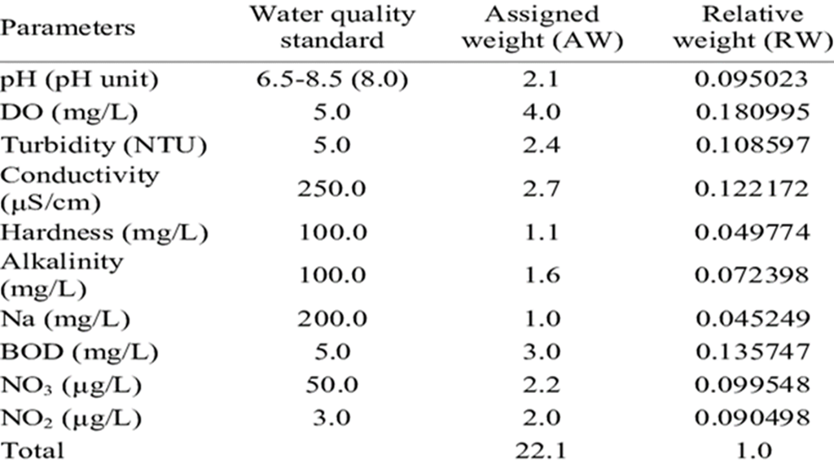
WHY WE NEED THIS?
As per normal water parameter in our dataset we have to check all of the parameter of water . we need to check the quality of water is good or not because Only 3 % of Earth's water is fresh water. 1 % of this fresh water is fit for drinking, rest is locked up in the ground, glaciers and ice caps . water is essential for our life.
As normal water parameter are -

Slide 7
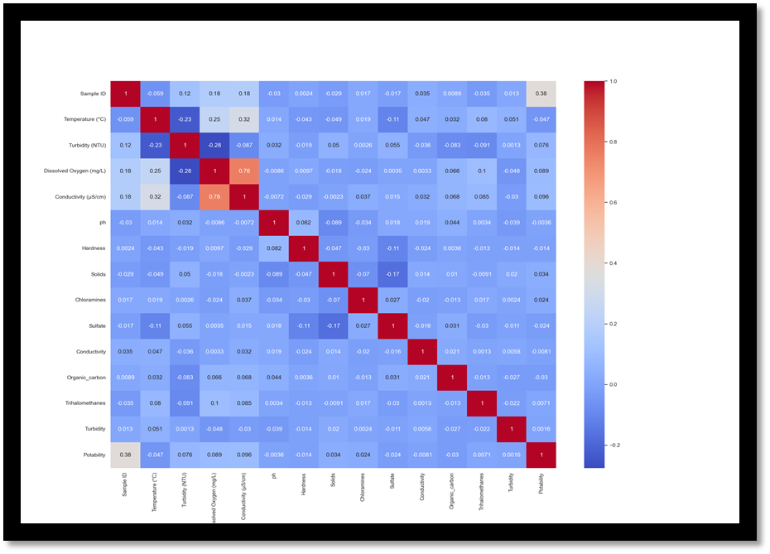
SOLUTION
Address the quality and sustainability of water resources, which are critical to the survival of people and the planet. So we have to check the quality of water for every thing.

Slide 8
MODELLING (ANALYSIS MODEL)AND VISUALISATION
Take csv file
Then CSV File give full information
Then describe of water backup in csv file
Then we analyze the data
Then we get prediction

Slide 9
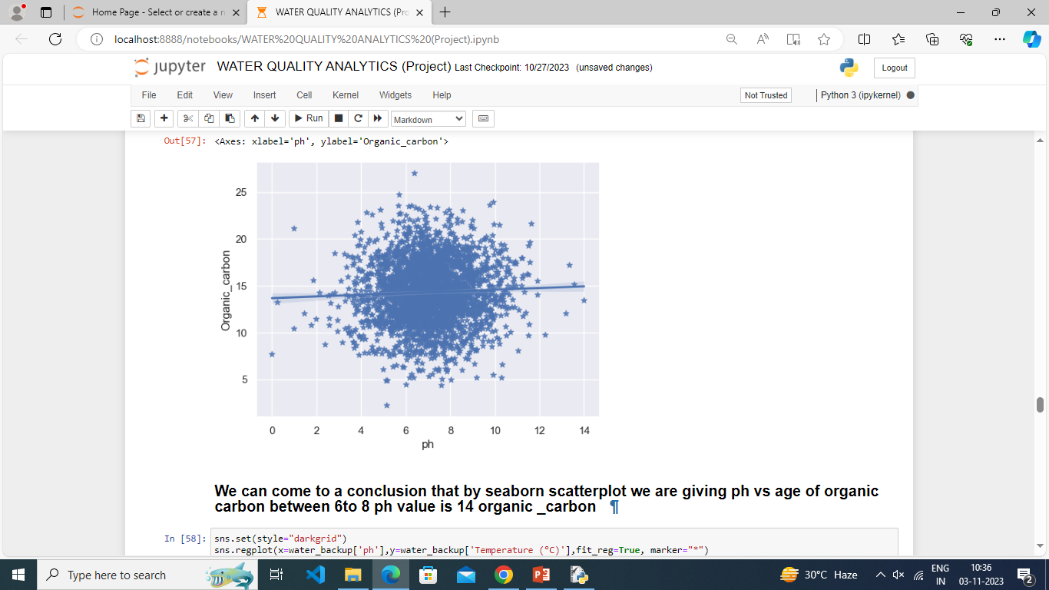
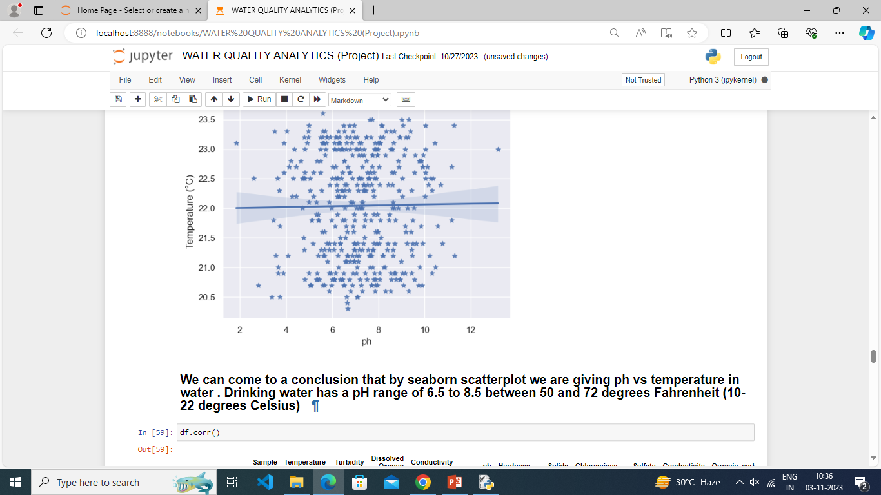
RESULT(PREDICTION MODEL)

Slide 10
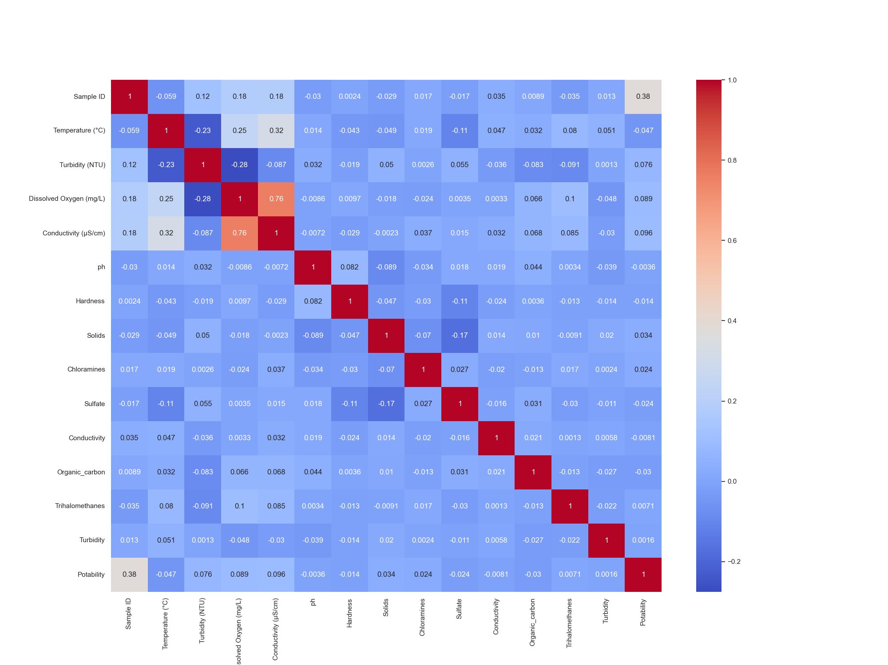
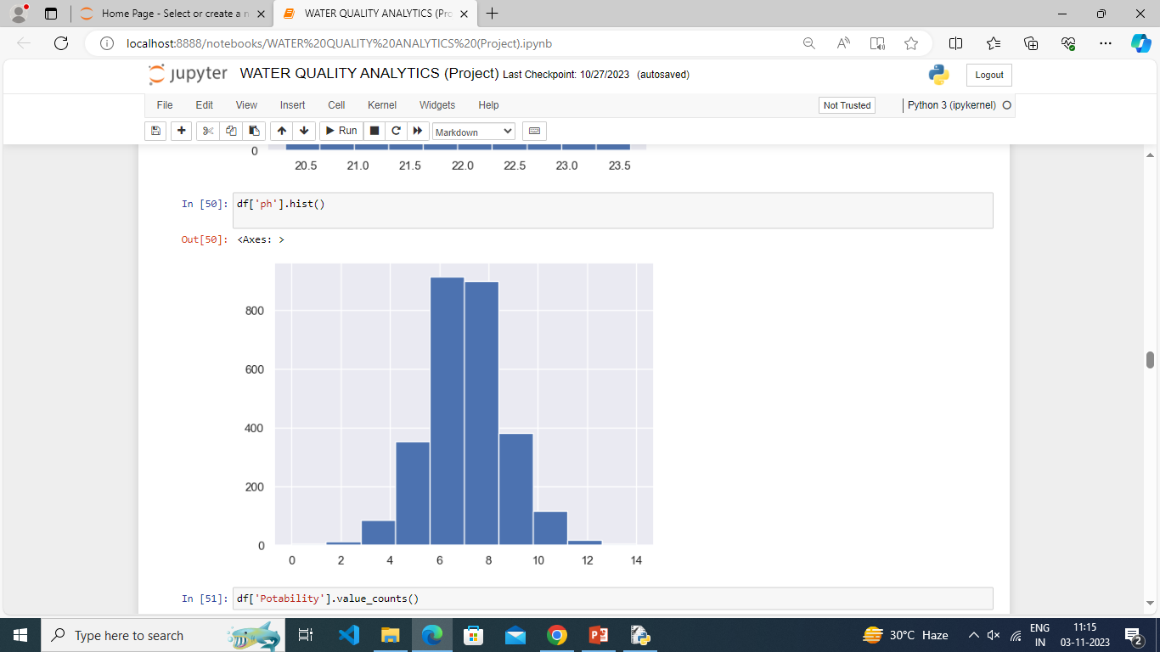
RESULT(PREDICTION MODEL) (cont.)

Slide 11
THANK YOU

